Slide 1
Relations between Sustainable Development Goals in the literature
Andrei Boar – UPF – Barcelona School of Management
ACCID 09.07.2020

Slide 2
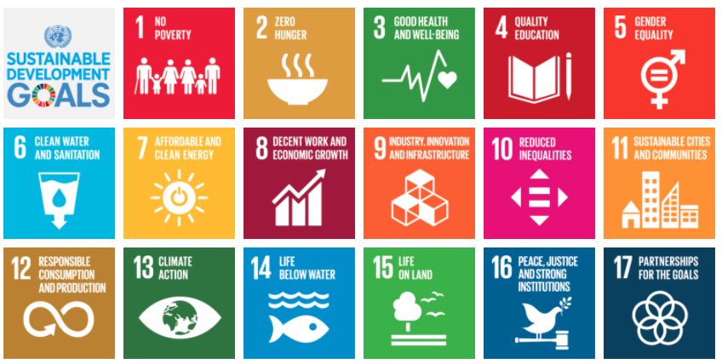
1. Introduction
What are Sustainable Development Goals?
169 targets
2030
Notes:
In terms of users, this study published in 2017 predicted that by 2022 up to 36% of the population would be using this type of services in the US
So, as a conclusion, we can see that this sector is being successful in terms of popularity, revenues and number of users.

Slide 3
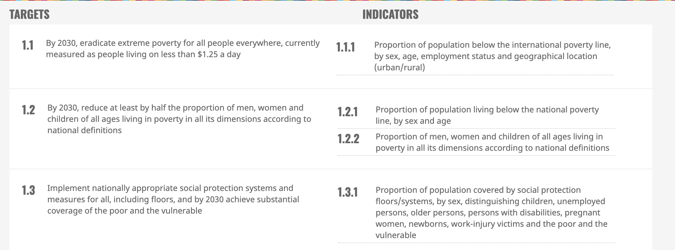
1. Introduction
What are Sustainable Development Goals?
Main objective of research: discover the relations between SDG in the literature, as a first step to apply them to business.
Notes:
In terms of users, this study published in 2017 predicted that by 2022 up to 36% of the population would be using this type of services in the US
So, as a conclusion, we can see that this sector is being successful in terms of popularity, revenues and number of users.

Slide 4
ODS Relations
Descriptive analysis
Keywords | (“SDG” or “Sustainable Development Goal”) AND (“synerg*” or “interaction” or “correla*”.)
Date | From 2015 to February 2020
Web of Science | 218
Scopus | 212
Total of papers | 430
Duplicates | 177
Total without duplicates | 285
Category | Number of articles
Interactions among SDG | 20
SDG + another topic | 87
Another topic | 178
TOTAL | 285

Slide 5
ODS Relations
1. Descriptive analysis
Papers distribution by publication year
Papers distribution by main topic
Papers distribution by data sources

Slide 6
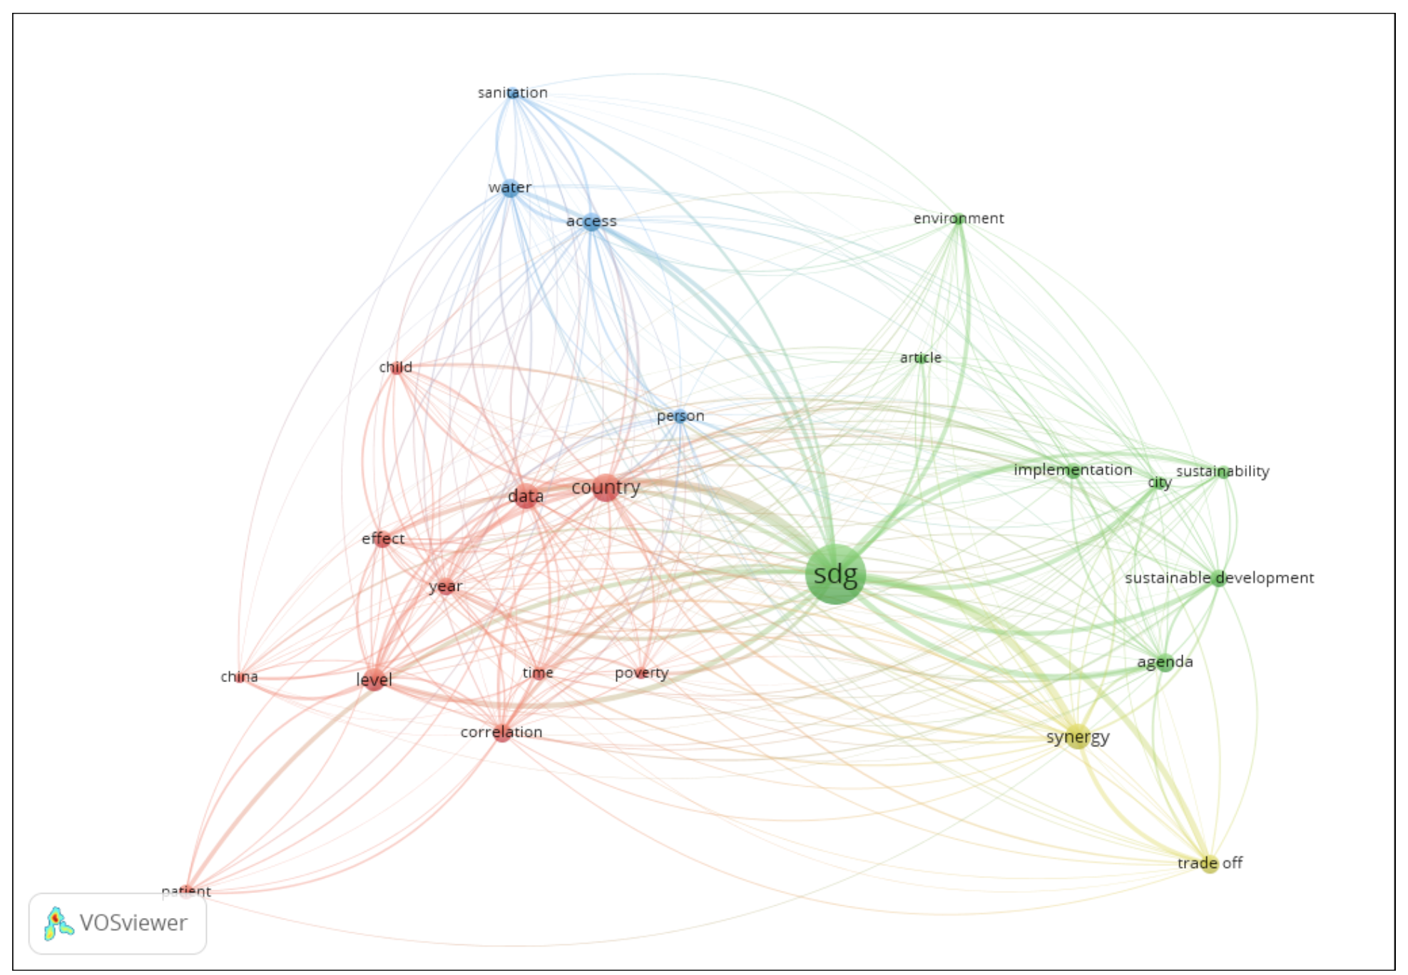
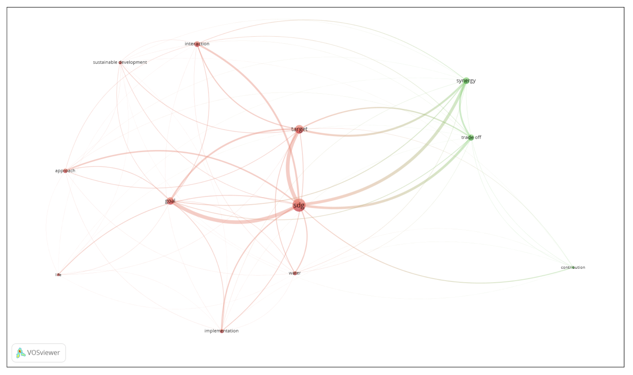
ODS Relations
2. Relations with VosViewer
Selected papers
All papers

Slide 7
ODS Relations
3. Content analysis
Main tool:
Nilsson et al. (2016).
Existence of synergies and trade-off between and among SDG. How? Using targets or indicators
Seven-point scale
+3 | +2 | +1 | 0 | -1 | -2 | -3
Indivisible | Reinforcing | Enabling | Consistent | Constraining | Counteracting | Cancelling

Slide 8
ODS Relations
4. Types of models
Jaramillo et al. (2019)
Pradhan et al. (2017)

Slide 9
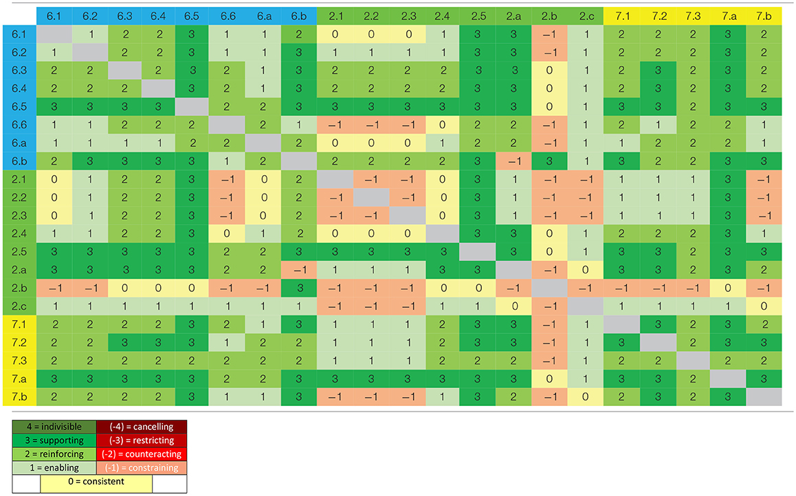
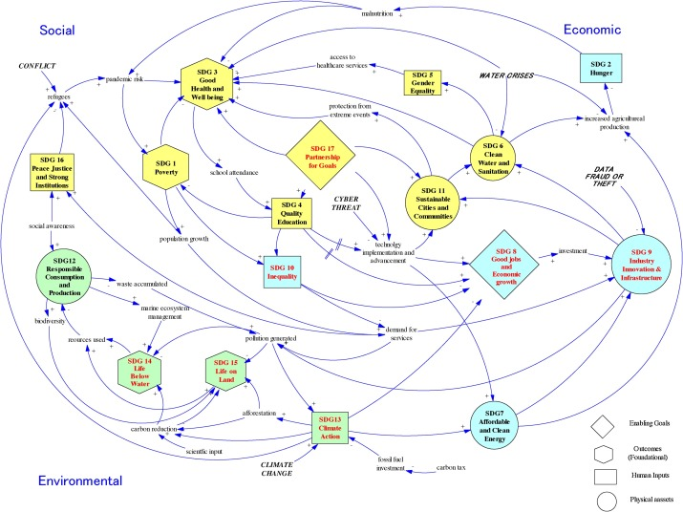
ODS Relations
4. Types of models
Fader et al. (2018)
Cernev & Fenner (2020)

Slide 10
ODS Relations
5. Models content analysis – main results

Slide 11
ODS Relations
6. Gaps
Literature | Topic | Future question research
Gap | Companies? | Which are the actions that companies can take for SDG?
Gap | Countries? | Which actions taken by countries allow to create synergies between SDG?
Gap | Energy | How can energy be used to achieve full economic growth, but without a negative impact on SDG?
Gap | Agriculture | How can be improved the efficiency of sustainable agriculture?
Disagreement | Inequality | Actions of SDG 8, economical growth, create synergies or trade-off with inequalities?
Gap | Business models | Which are the business models that allow economic growth without a negative environmental effect?

Slide 12
ODS Relations
6. Conclusions
A new topic in the literature that will grow in the next years. Until now is full of gaps and disagreements.
Synergies are reducing and trade-offs are increasing.
We need to focus our education in responsible and green education.
We need to focus in the use of renewable energy.
We need to create or improve business models that promote economic growth without affecting negatively the environment.

Slide 13
Relations between Sustainable Development Goals in the literature
Andrei Boar – UPF – Barcelona School of Management
ACCID 09.07.2020

